Slide 1
Neural Style Transfer (NST)
Sean Goldthwaite

Slide 2
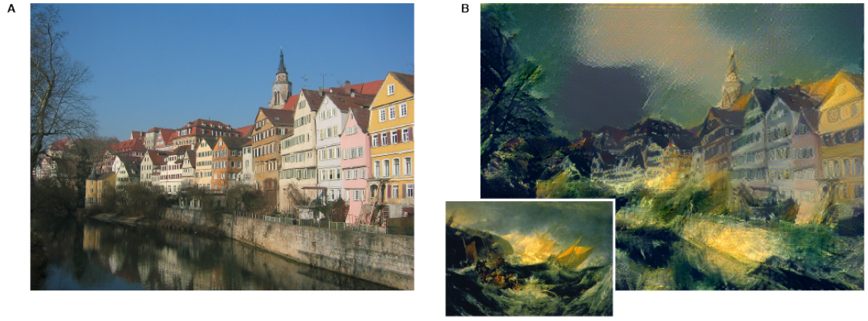
What is it? Example from Gatys research paper
Content Image
Riverfront in Tübingen, Germany
Content + Style
From Gatys et. al
Style Image
The Shipwreck of the Minotaur by J.M.W Turner

Slide 3
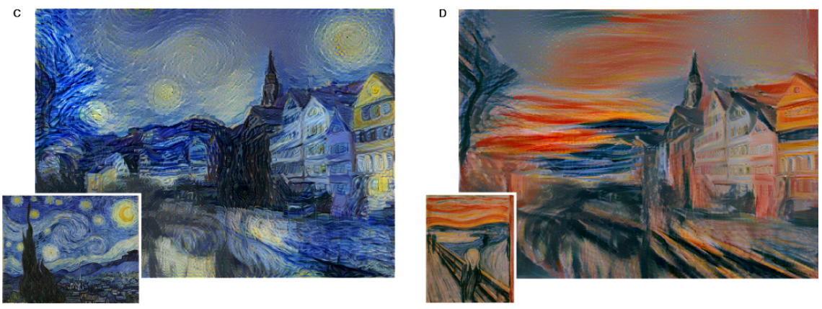
Other examples from Gatys
The Starry Night by Vincent van Gogh
Der Schrei by Edvard Munch

Slide 4
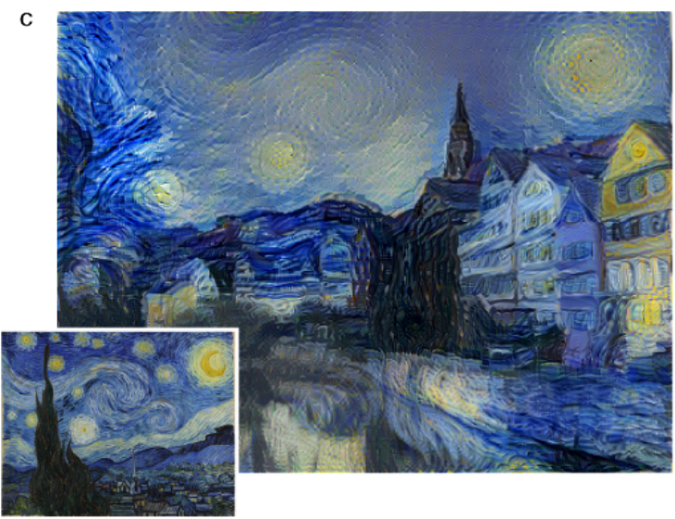
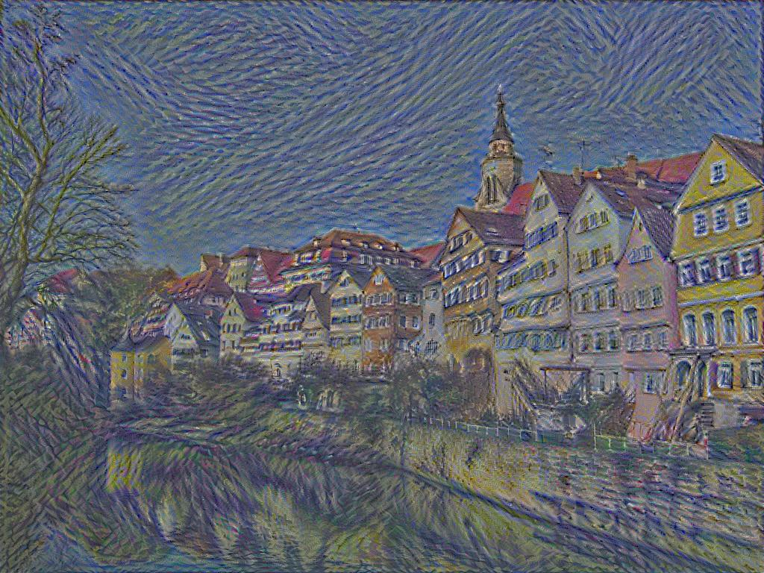
My results compared to Gatys
Gatys
My work

Slide 5
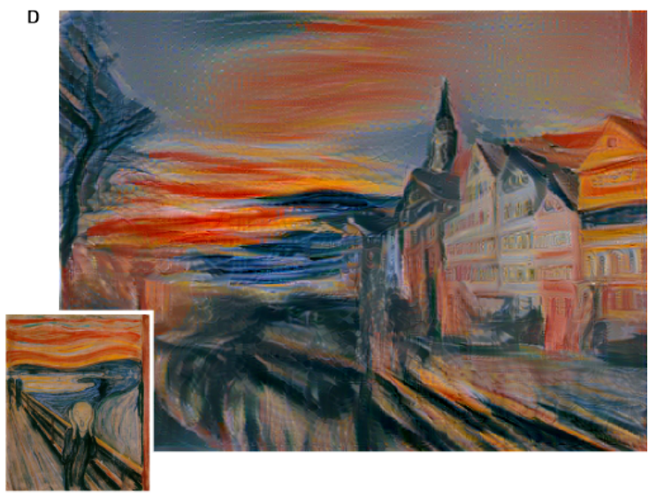
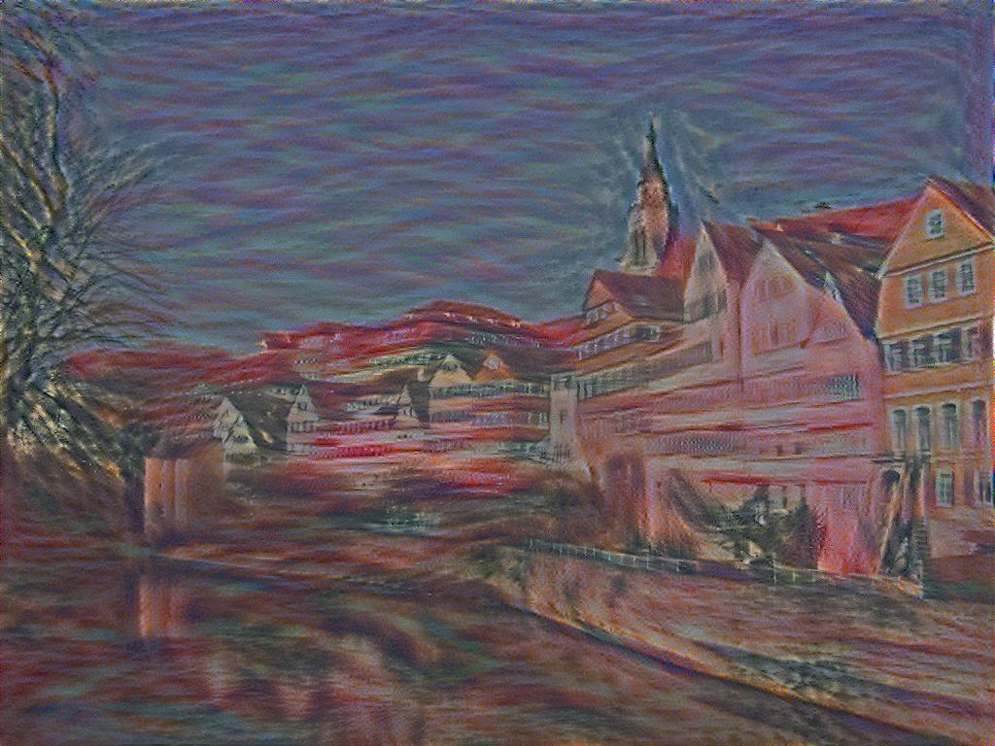
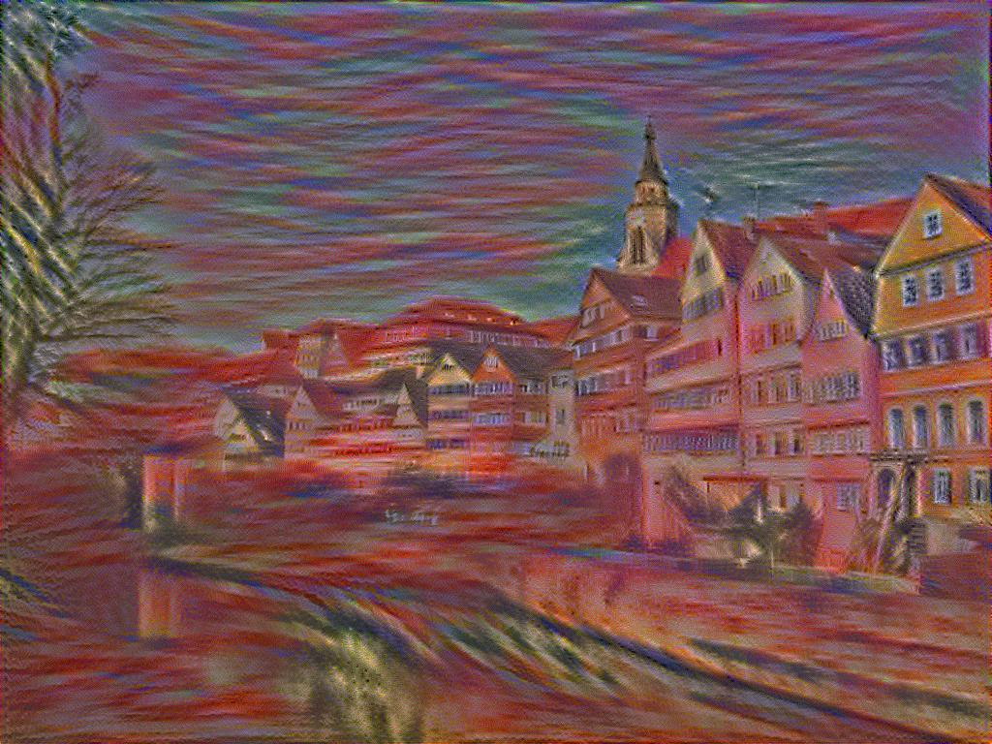
Comparison cont.
Gatys
My work

Slide 6
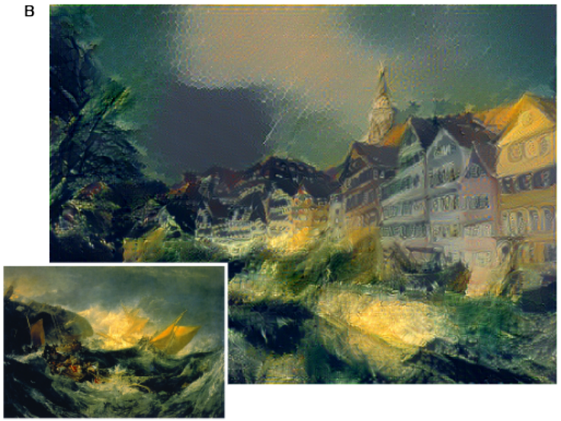
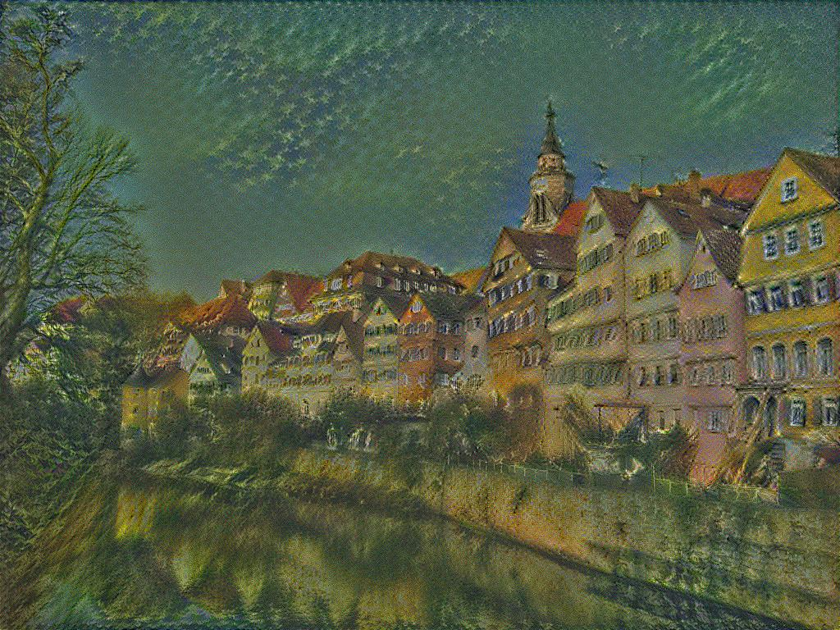
Comparison cont.
Gatys
My work

Slide 7
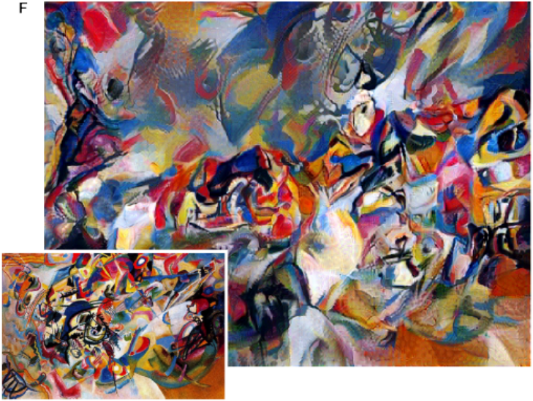
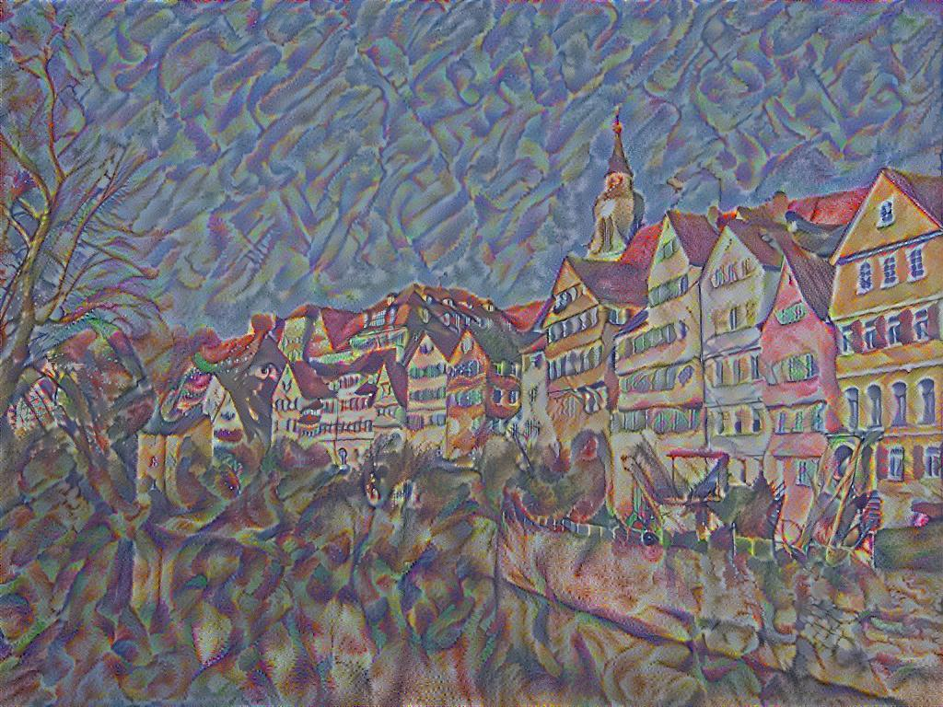
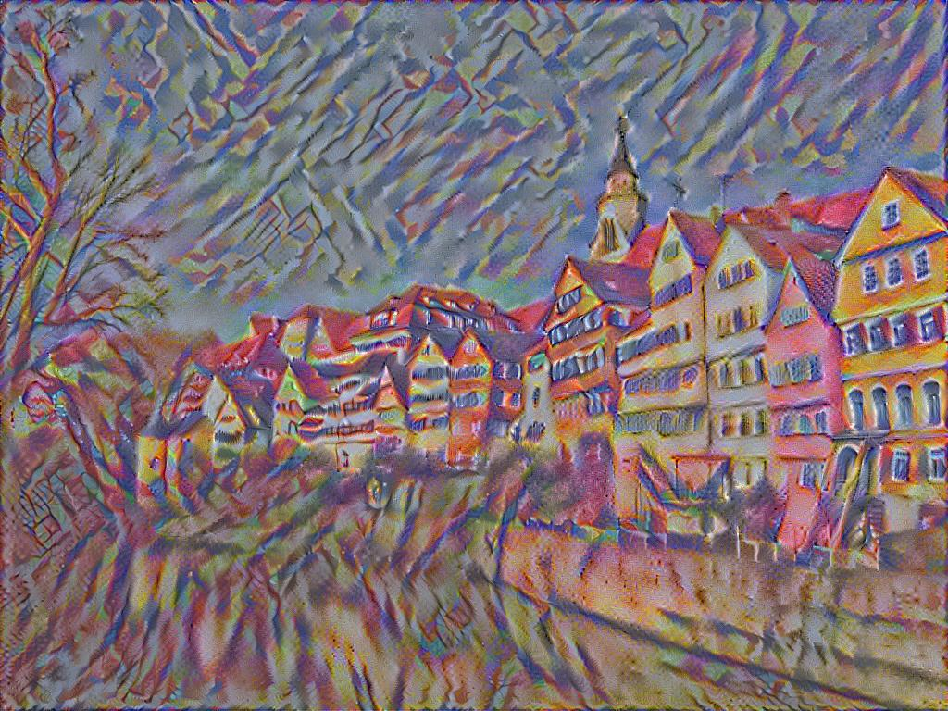
Comparison cont.
Gatys
My work
Composition VII by Wassily Kandinsky

Slide 8
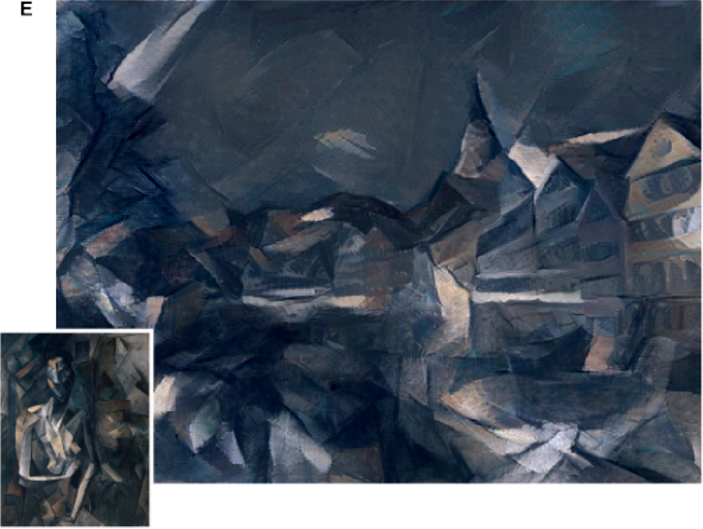
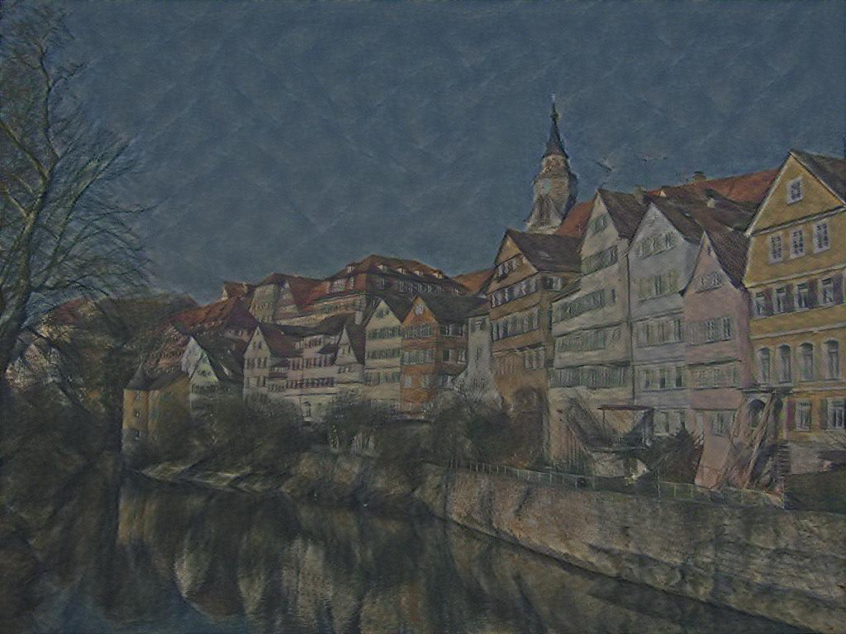
Comparison cont.
Gatys
My work
Femme neu assise by Pablo Picasso

Slide 9
How does it work? Very generally
Observations about CNNs for object recognition
Must ignore the small style differences for good recognition
So the activations at each layer must somehow encode the content
Style can be extracted using a Gram matrix (inner product between vectorized feature maps)
How to create an image:
Start with a white noise image
Content loss is the difference between layer activations of the content and generated images
Style loss is the difference between the Gram matrices of the style and generated images
Perform gradient descent

Slide 10
That’s all

